Slide 1
Online Consumer Complaint Filing
E-filing of complaint at Consumer Forums of India
Write Response
Are you an opposite party involved in a case?
Do you want to write a response online?
Go to Edaakhil Portal www.edaakhil.nic.in
To become a registered user

Slide 2
Registration
On the Edaakhil Portal’s Home Page
Click on Complainant/Advocate Section--> Registration
Register UserId to get OTP
2. Get activation link through OTP
3. Activate Link in email received on your email account

Slide 3
When a RESPONSE can be written by opposite party?
For an approved complaint , response can be submitted to concerned commission.
2. For an approved response, rejoinder can be filed by complainant.
Complaint Submitted Approved By Commission
Opposite Party writes Response Approved By Commission
Complainant Files Rejoinder Approved by Commission
For an approved complaint
For an approved response

Slide 4
User Login
User Login
Click on Complainant/Advocate Section
2. Click on Login submenu.
Next page
LOGIN SCREEN

Slide 5
Write Response by Opposite Party : File Response (for filed case CC )
Once case is approved by the forum ,
Opposite parties could take action on filed case.
Opposite Party involved in the case could write a response.
To file a response for CC case type, opposite party is required to login and go to
Write Response menu and click on File Response(by Respondent) submenu

Slide 6
Write Response by Opposite Party : File Response (for filed case CC )
Case for which response is to be written could be located/searched either by Fano or by reference Number
1. Search by Reference Number:
Put in Case Reference number in the right panel and
Click on submit button
OR
2. Search by Fano/Caseno:
Select the consumer Forum
Put in case number/FANO
Click on submit button.

Slide 7
Write Response by Opposite Party : File Response(for filed case CC )
Next Page opens up with 5 tabs . Each represents different sections of case details.
Case Details Tab will show the some basic details related to the case like referenece n, Case number, amount , hearing date etc.

Slide 8
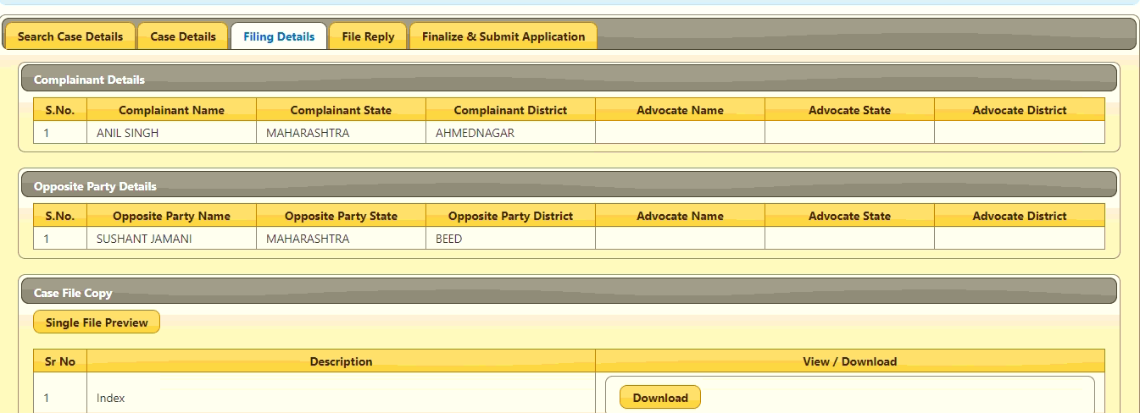
Write Response by Opposite Party : File Response (for filed case CC )
Adjacent to Case Details tab is Filing Details tab
Here you will get information about complainants and respondents and submitted documents by the petitioner.

Slide 9
Write Response by Opposite Party : File Response (for filed case CC )
Filing Details cont…..
Uploaded Documents by complainant will be visible to opposite party by clicking on download button.
The documents will get downloaded and can be viewed by respondent.

Slide 10
Write Response by Opposite Party : File Response (for filed case CC )
File Reply Tab:
Upload the required documents.
Any additional document can be uploaded by clicking on Add Document button.
The same can be downloaded by clicking on the Download button

Slide 11
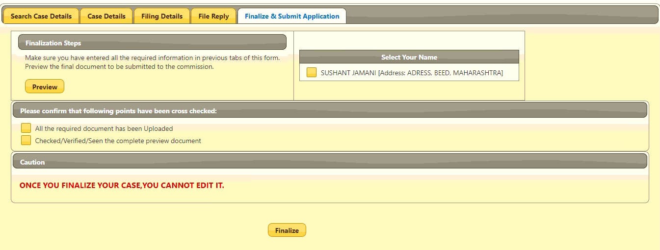
Write Response by Opposite Party : File Response (for filed case CC )
Finalize and Submit Application:
Click on Preview button to view the uploaded documents
Mark tick on the checkbox besides your name.
Please confirm by marking the checkboxes tick if required documents and information have been provided.
Click on Finalize button
2
1
3
4

Slide 12
Write Response by Opposite Party : File Response (for filed case CC )
• Enter the OTP received
• Click on Continue button to submit response to the Fora for approval

Slide 13
Write Response by Opposite Party : File Response (for filed case CC )
Once response gets submitted successfully to the forum,
User will get an acknowledgement.
Now, commission will take action after verification of the documents
Complaint might get rejected or approved .

Slide 14
Write Response by Opposite Party : View Response Status (for filed case CC )
This will show the status of the response submitted by the respondent
“PENDAPRV” status in the screenshot below defines that approval is pending by the Fora.
If the response gets Reverted by the forum then submit the response again.
Response status “Approve” signifies approval has been granted by the forum.
Click on “View” button to get details.
Next page
When View Button is clicked. It will open a next page displaying the case details

Slide 15
THANK YOU
Help Desk: 011-24305332 |Confonet-info@nic.in

