Slide 1
Online Consumer Complaint Filing
E-filing of complaints at Consumer Forums of India

Slide 2
Online Consumer Complaint Filing
Complaint Filing at the comfort of your home has now become feasible with the newly launched Edaakhil Application. A user , may be a complainant or an advocate , can file a complaint online at his/her ease. No more visits to the consumer forum are required

Slide 3
Registered User?
Visit e-filing portal www.edaakhil.nic.in to register your email id and become a registered user
Without a registered user id , complaint filing process could not be started.

Slide 4
How to start?
To file a new Complaint, user must have
A valid EmailId : to get registered on Edaakhil portal
2. Soft copies of Identity Proof: Voter Id/ Pan Card/ Passport/ Ration Card/BPL/AAY Card/Driving Licence.
3. Document Format should be PDF only.

Slide 5
Go to http://edaakhil.nic.in/
Click on “Enter Website” button

Slide 6
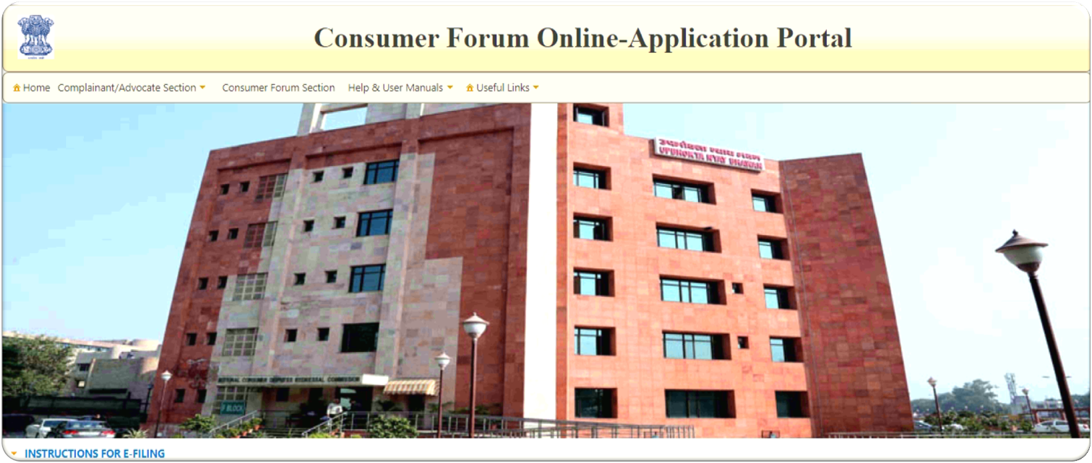
Edaakhil Application Home Page

Slide 7
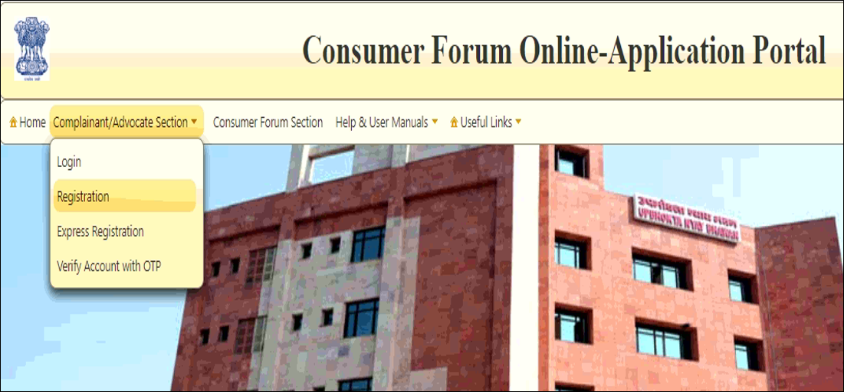
User Registration
User Registration:
1)Click on Complainant/Advocate Section
2) Click on Registration

Slide 8
User Registration Process
Register Email id
STEP 1
Get OTP
STEP 2
Activate Account
STEP 3

Slide 9
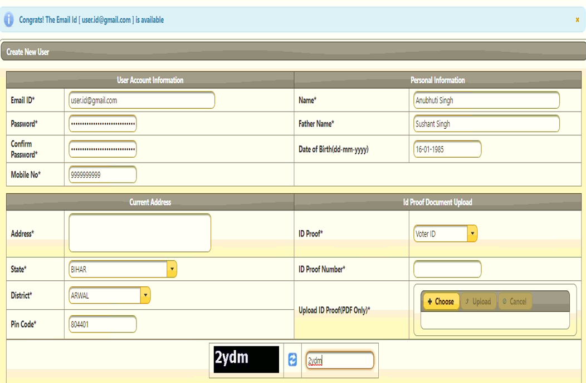
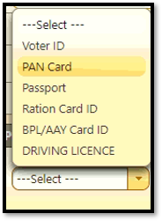
User Registration : Register Email ID
Fill out all the details on the User Registration Page
New User Account Creation
Type in a valid email id. User will be notified at the same time if Id is available
Password should be alphanumeric , 7 characters long include 1 numeric character,atleast1upper case and 1 lower case letter, 1 special character.
Type in Confirm Password
Valid mobile number to get OTP and other notifications later
Type in your Name , Father’s Name and DOB
Provide current location address details
7.Select the Id Proof
8.Type in respective Id Proof No
9.Upload Id Proof in Pdf format
10. Type in captcha code as shown
11. Click on Submit Button
1
2

Slide 10
User Registration : GET OTP
OTP sent on Registered Mobile no
After Submit button is clicked on User Registration screen
User will get OTP on the registered mobile number.
2. OTP will be valid for 15 minutes.

Slide 11
User Registration : Activate Account
Receive Activation Link on email Id
Type in email id
Enter OTP received on mobile number
Click on Continue button to get User activation link on email id
A confirmation email to activate account will be sent to the registered email id

Slide 12
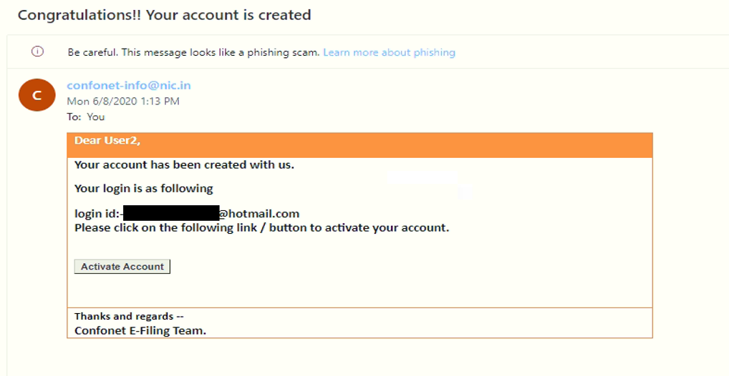
User Registration : Activate Account continues………
Activate Account
Login to Email account
Open the email received in Inbox from confonet email address
Click on Activate Account button
2. User activated successfully message
is displayed.
Next page

Slide 13
Thank You

