Slide 1
Online Application Filing
E-filing of Complaints at Consumer Commissions of India
Filing IA /MA on Complaints Filed Online
Login to the Edaakhil online portal to start filing Applications
(IA/MA) online
www.edaakhil.nic.in

Slide 2
USER Home Screen: Application Filing
After successful login, User Home screen will show “Case Filing Application” menu
Click on “Filing Application” submenu under “Case Filing application” menu

Slide 3
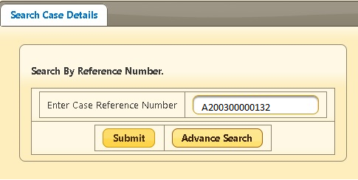
Search BY E-Daakhil REFERENCE NUMBER:
Search complaint details using Reference Number
Enter the Reference number and click on Submit button

Slide 4
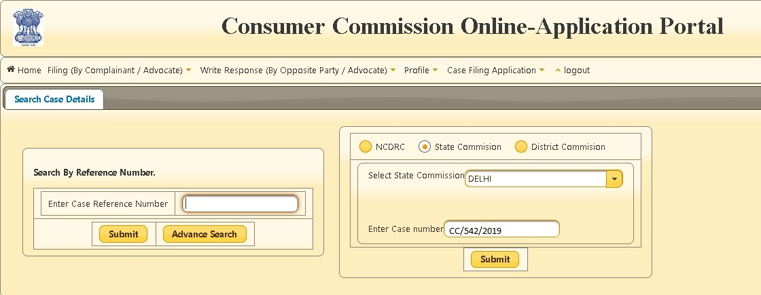
ADVANCE Search BY CASE NUMBER:
Search complaint details by clicking on Advance Search button from the left panel
Choose the level of Commission by clicking on radio button from the right panel displayed on the right
Select the commission name from the dropdown list
Enter the case number
Click on Submit button

Slide 5
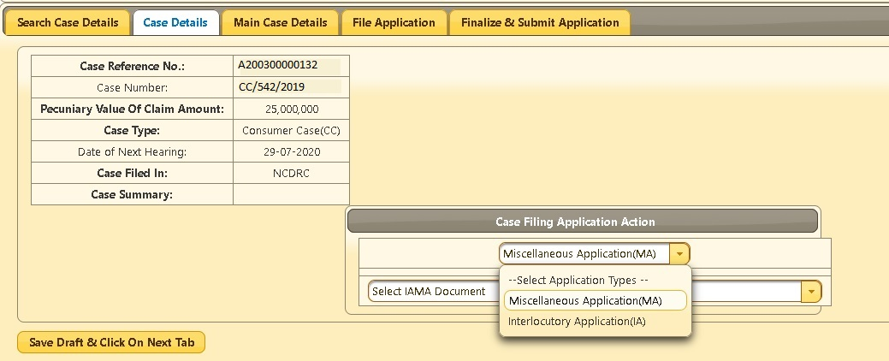
CASE DETAILS:
The next page ”Case Details ” will display details of the searched complaint .
Select the type of application (IA/MA) from the “Select Application Types” dropdown list
Select the IA /MA Document from the dropdown list
Select Application type and document type
Click on
“Save Draft & Click on Next Tab” button to save the details

Slide 6
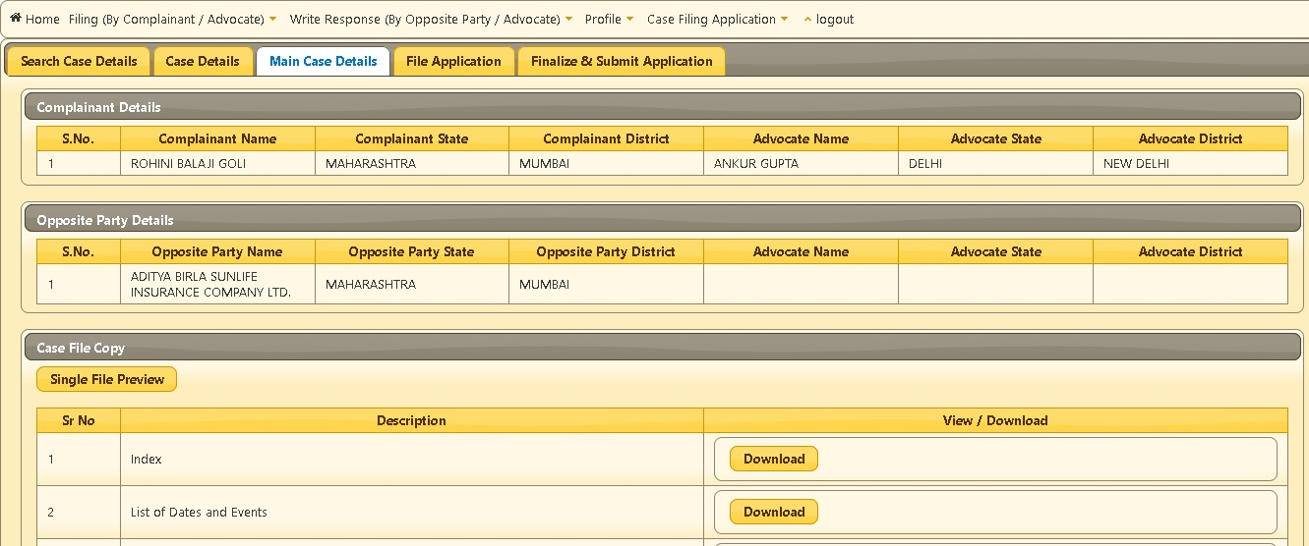
MAIN CASE DETAILS:
On Next Tab, it will show Main Case Details and the uploaded documents
To get all documents in a single file, click on “Single File Preview” button
The documents can be separately downloadable by clicking 0n “Download” button

Slide 7
FILE APPLICATION:
Click on Next Tab “File Application”
To Upload all the mandatory documents , click on “Choose” button to select the document
Then, click on “Upload“ button
To upload any additional document, click on “Add Document” button, name it by double clicking white space under description and upload the relevant document

Slide 8
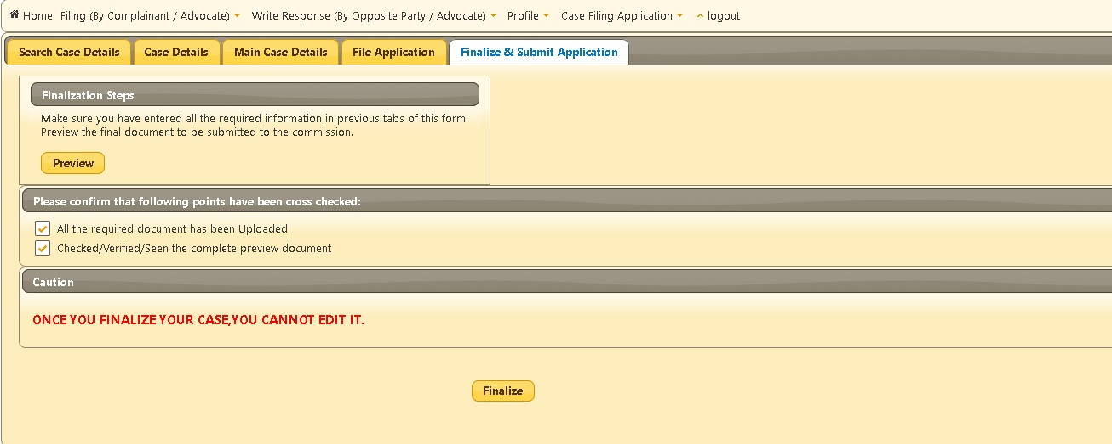
FINALIZE AND SUBMIT APPLICATION:
Click on “Finalize and Submit Application” tab
Click on “Preview” button to get a single view of all the uploaded documents
Mark the checkboxes tick to ensure all the documents have been uploaded correctly
Click on “Finalize” button to submit the application.
Before Final submission, an OTP is received on registered mobile number

Slide 9
OTP FORM:
Enter OTP received on mobile number and click on Continue button
To get a new OTP , click on Resend OTP button
After clicking on Continue button, an acknowledgment message will be displayed on the screen and it will get submitted to the consumer commission

Slide 10
View PENDING APPLICATIONs:
Click on “Pending Application” under “Case Filing Application” to view the list of applications that have been submitted to the commission and are not approved yet.

Slide 11
List OF PENDING APPLICATIONS:
The UI below will list applications that are pending to be approved by the consumer commission

Slide 12
List OF APPROVED/REVERTED APPLICATIONS:
Commission approved complaints could be seen on the click of “Approved Applications” under
“Case Filing Applications”
If an application is reverted by the commission then view the details by clicking “Revert Applications” under “Case Filing Applications.
The UI below appears on the click of “Approved Applications” submenu under “Case Filing Applications” menu.
It displays the list of applications that have approved by the commission

Slide 13
THANK YOU
ONLINE APPLICATION FILING
Help Desk: 011-24305332 | e-daakhil@nic.in

