Slide 1
Online Consumer Complaint Filing
E-filing of Complaints at Consumer Commissions of India
Filing First Appeal Online
If you are a registered user on the Edaakhil online portal, a digital platform to
file consumer complaints
www.edaakhil.nic.in

Slide 2
USER REGISTRATION
On the Edaakhil Portal's Home Page
Click on Complainant/Advocate Menu --> Registration submenu
Register user id to get OTP
Get activation link through OTP
3. Activate Link in email received on your email account

Slide 3
Want to File First Appeal online?
1. Login with activated user id/ email id
2. Start Filing your case
User Login
Click on Complainant/Advocate Section
Click on Login submenu.

Slide 4
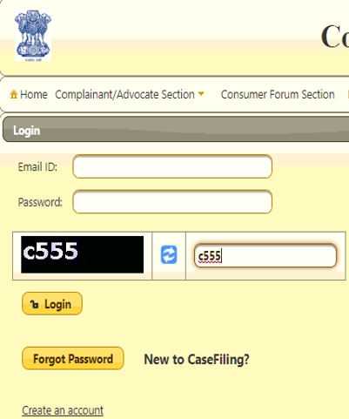
User Login : Login Screen
LOGIN SCREEN
Login using the EmailId and Password
Enter Email Id
Type in Password
3. Enter the captcha code in the field as shown
4. Click on Login button

Slide 5
Successfull Login: User Home Screen
User Login: Success
User Home screen with welcome message will be shown after successful login with user name displayed on extreme right.
Filing : This menu can be accessed to file a new complaint or rejoinder and to check case status, pending draft ,pending payment or view approved cases list.
Profile : Mange or Update your account details
Logout: Click on Logout button to exit from user account.
1
2
3
4

Slide 6
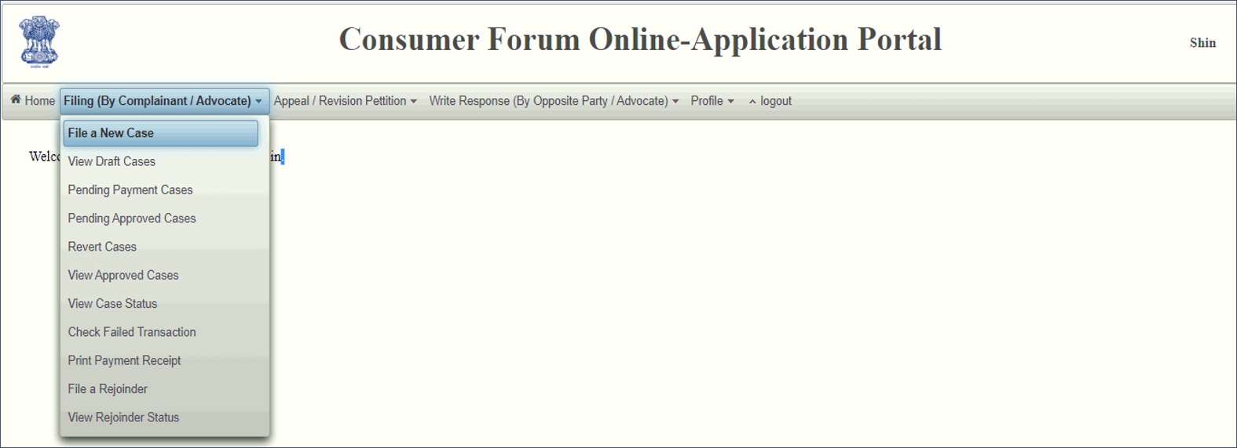
Filing: File FIRST APPEAL
Filing FA :
Click on the Filing(By Complainant/Advocate) dropdown Menu
Then, click on File a New Case submenu

Slide 7
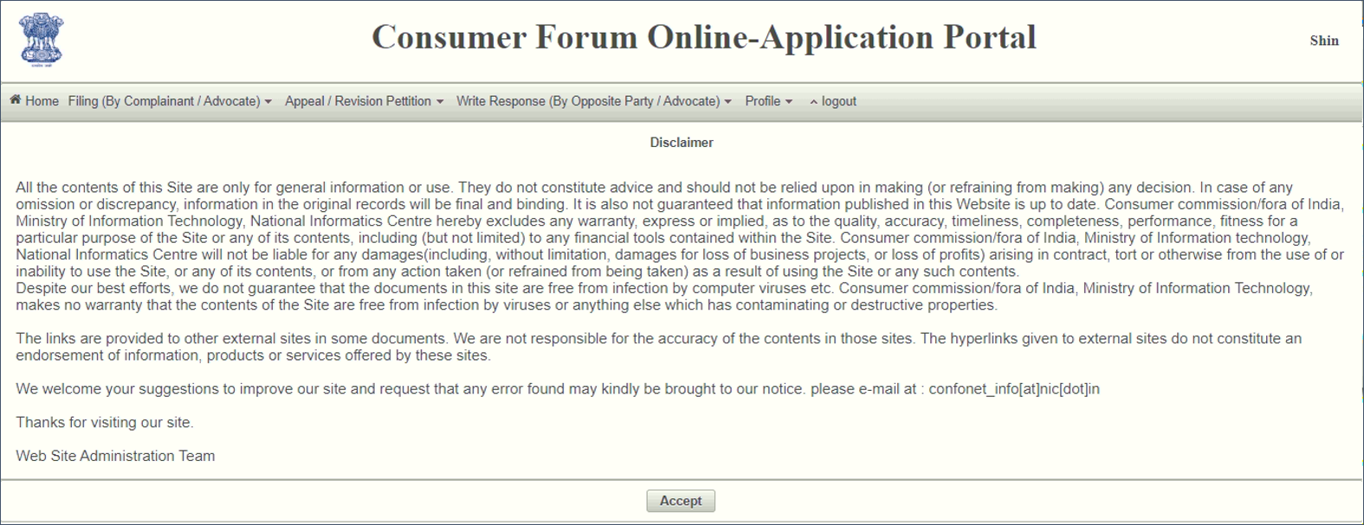
Filing: File FIRST APPEAL
Read the disclaimer and Click on Accept button

Slide 8
Filing : File FIRST APPEAL
Complaint Types : The next interface will show three case types, user could choose
from
Consumer Case (CC) visible in left panel
Revision Petition (RP) and First Appeal (FA) shown in right panel to be filed in NCDRC
Click on First Appeal Radio Button visible on the right pannel
1
2
3

Slide 9
Filing: File FIRST APPEAL
File a First Appeal
Select the Forum State from the dropdown list.

Slide 10
Filing: File FIRST APPEAL
File a First Appeal
Enter the associated case number for which First Appeal is being filed.
Click on Search button. this will display
Scenario1: Consumer case details will be displayed below
Scenario2: No record found message

Slide 11
Filing: File FIRST APPEAL
File a First Appeal
Scenario1: When CC number as entered by user, found online and it shows matched CC details.
Check the details and Click on Start Filing Your Case button

Slide 12
Filing: File FIRST APPEAL
Scenario2:When CC number as entered by user, did not match and
no record is found.
Click on Manual Entry Button to fill in associated case details manually.

Slide 13
Filing: File FIRST APPEAL
Scenario 2
Type in Consumer Complaint Details
Click on Start Filing Your Case button

Slide 14
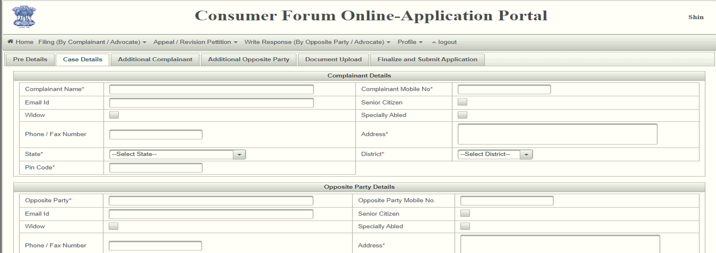
Filing: File FIRST APPEAL
When Start filing Your Case Button is clicked on previous screen
The next UI will be Case Details page.

Slide 15
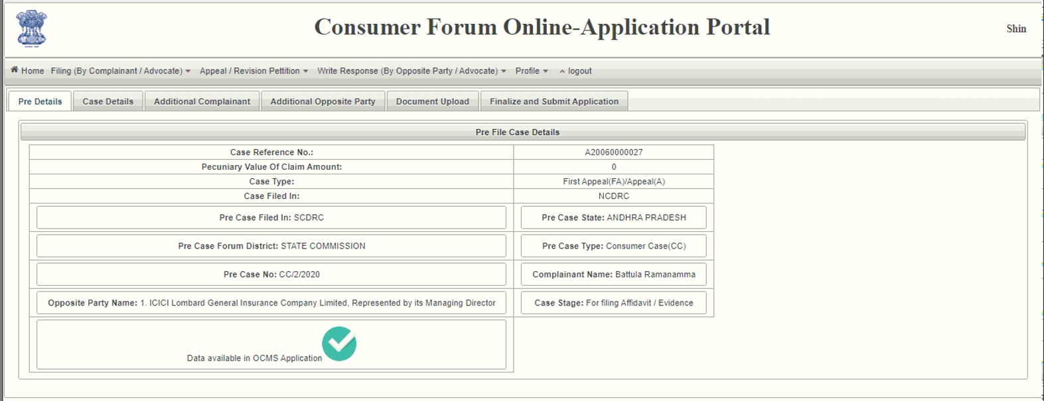
Filing: File FIRST APPEAL
1. Pre-Details screen
Details of FA case are shown. It displays case ref no., claim amount and
the state commission where case is filed in, complainant & opposite party name and case stage. In addition, fields preceded with "Pre Case" tag name , displays associated consumer case details.
At the bottom of the page, the tick mark sign indicates that the associated case details are available online

Slide 16
Filing: File FIRST APPEAL
2. Case Details:
Fill out Complainant Details, Respondent Details and Complainant's Advocate Details
User could switch to different tabs to edit the details before finalizing
Click on Save Draft and Click on Next Tab.

Slide 17
Filing: File FIRST APPEAL
3. Additional Complainant Details
Mark the additional complainant and advocate checkboxes tick to fill in details
Click on Add button.
After adding record, Edit button can be clicked to make changes and click on Update button to save the changes
Click on "Save Draft and Click on Next Tab" button

Slide 18
Filing: File FIRST APPEAL
4. Additional Opposite Party Details
Mark the checkboxes tick in additional opposite party and advocate section
Fill in the details in the required fields and Click on add button.
To modify, click on Edit button given alongside and click on Update button
Click on Save Draft and Click on Next Tab.

Slide 19
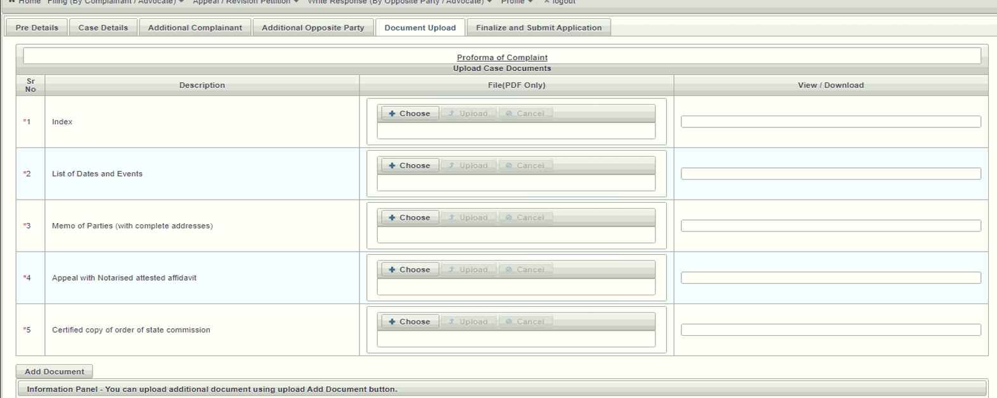
Filing: File FIRST APPEAL
5. Document Upload
Switch to Document Upload Tab: In case of FA , total of 5 documents must be uploaded.
Click on choose button, select the file to upload then click on Upload button.
Once uploaded, it will be viewable on click of Download button
To re upload,click on Delete upload File button.

Slide 20
Filing: File FIRST APPEAL
5. Document Upload
To upload additional documents, click on Add Document button.
Read the information given in the Information Panel.
Click on “Save Draft and Click on Next Tab” button

Slide 21
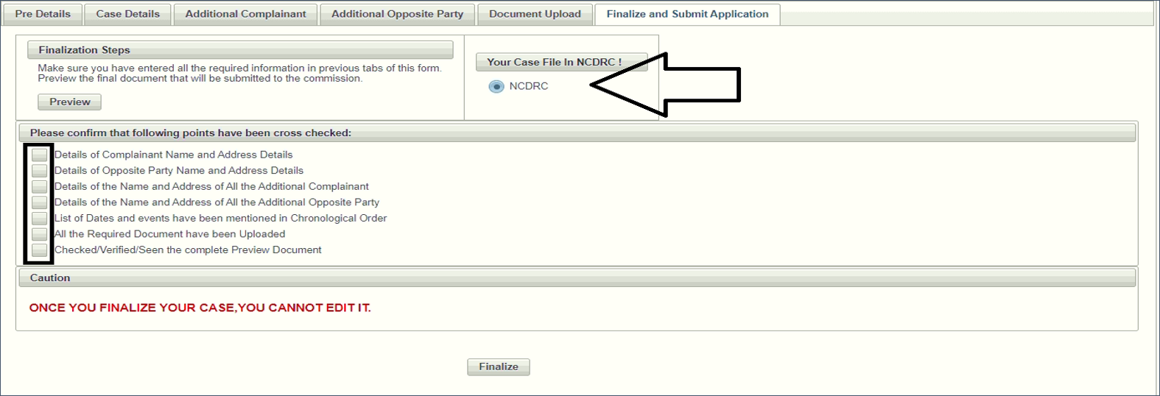
Filing: File FIRST APPEAL
6. Finalize and Submit Application
After filling in all the details, the last step towards completion is case finalize stage.
Click on Preview button under Finalization Steps to get a consolidated document as uploaded by user
Alongside, the panel in the right informs about the consumer forum where case is being filed.
Cross check all the details provided by you.

Slide 22
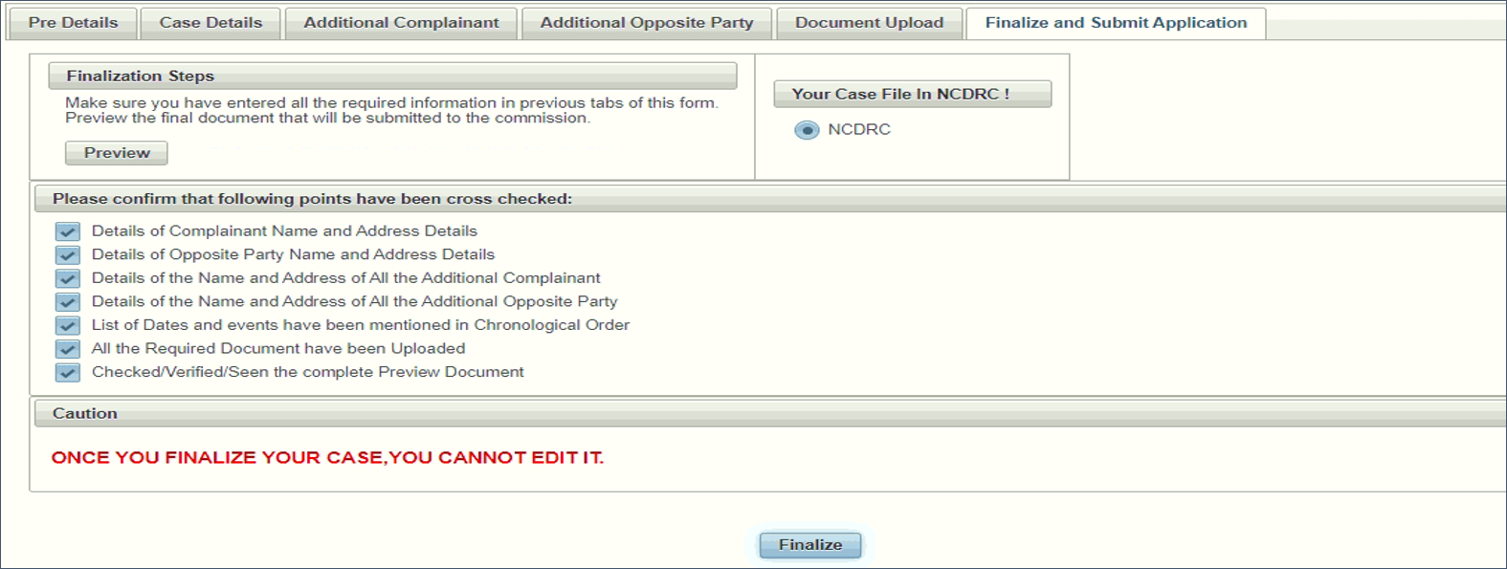
Filing: File FIRST APPEAL
6. Finalize and Submit Application
Mark the checkboxes tick and confirm that details have been provided correctly and necessary documents have been uploaded.
Click on Finalize button to finally submit the application into the forum.
Once finalized , details can not be edited.

Slide 23
Filing: File FIRST APPEAL
Finalize --> Enter received OTP
User will get an OTP on registered mobile number
Enter OTP received on mobile number
Click on Continue button
If OTP is not received by user , click on Resend OTP button to get a new OTP.
Now the case will get listed under Pending Approval Section or Pending Payment Section

Slide 24
Filing :File FIRST APPEAL
Finalize Confirmation Message
Case Finalized Acknowledgment will be displayed to the user.
Now the case will get listed under Pending Approval Section

Slide 25
Filing: File FIRST APPEAL
Pending Approval Cases
Here, case listed under "Pending Approval Cases" is yet to be approved by the commission
After Approval/ Revert By Commission
The case will respectively list under "Approved Cases" or "Revert cases" Heading .
User will get an alert on mobile phone that case has been approved.

Slide 26
Online Consumer Complaint Filing
E-filing of complaints at Consumer Commissions of India
THANK YOU
Help Desk: 011-24305332 |Confonet-info@nic.in

